Slide 1




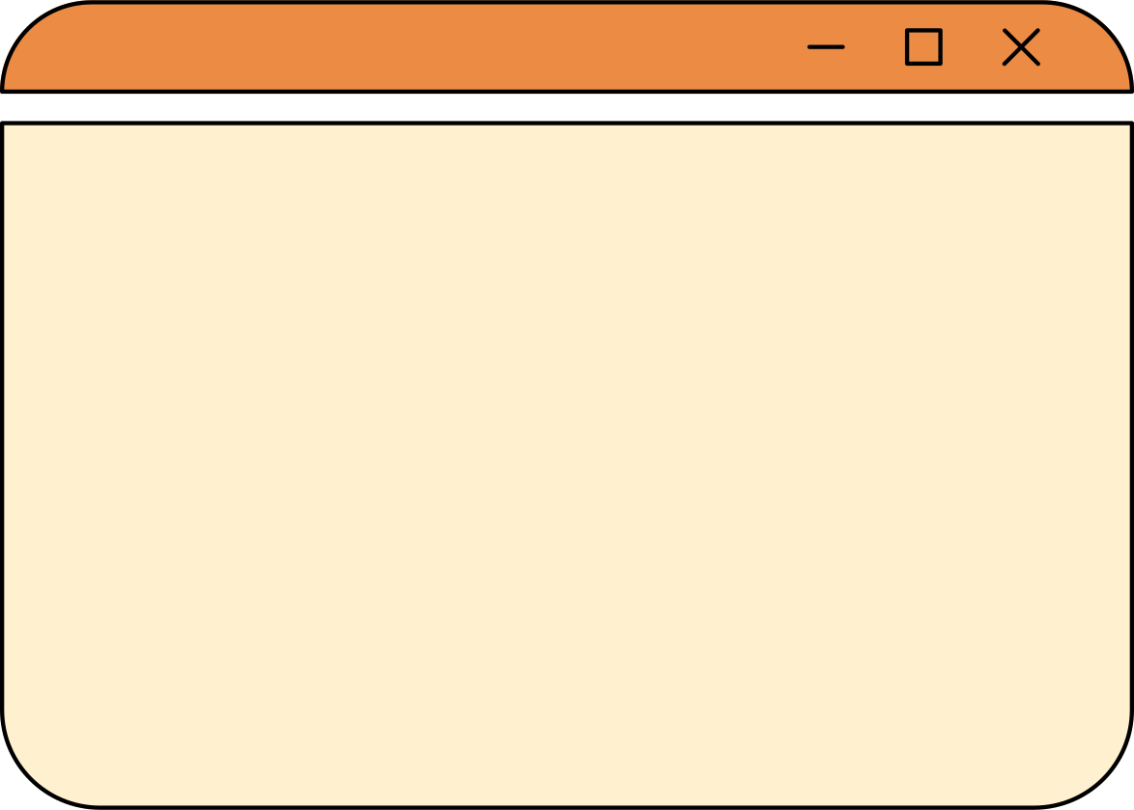



#101
CS Project Proposal Presentation
CS Project Proposal Presentation
Jazmin Mathea Canque and
Duane Rainer C. Macayan
8 - CAMIA
www.duaneiscute.com

Slide 2
Table of Contents
1
Project Title
5
Planned Features
2
Problem Statement
6
Planned Inputs and Outputs
3
Problem Description
7
Logic Plan
4
Project Objectives
8
Example Output

Slide 3







SmartSpend: Budget Calculator for Scholars
01

Slide 4



Project Statement
Based on our observation while roaming around the campus, some students have been complaining about having difficulty in managing their allowance properly, often spending too much on wants and unnecessary expenses. There is a need for a tool that helps them budget their money wisely and develop better spending habits.
02

Slide 5


Problem Description
We know that students receive their allowance or stipend, but it usually disappears fast because it’s spent on things we want, food deliveries, and other unnecessary stuff. Before you know it, you’re already saying “waray nak kwarta bruh”. That’s why we think it’s important to spend wisely, and a budget calculator can really help us manage our allowance better.
04

Slide 6



Project Objectives
•To create a program that calculates and tracks a student’s spending based on their allowance and chosen budget categories.
•To help students visualize how their money is divided among savings, necessities, wants, and school needs.
•To provide a simple and user-friendly interface suitable for students with little to no experience in budgeting
03

Slide 7

Planned Features
•Input system for total allowance and percentage allocations for categories, (Savings, Food, Necessities, Wants, School Purposes and etc.).
•Automatic computation of allocated amounts per category.
•Basic input validation to ensure percentages or values are valid.
•A clear display of all budget computations in one place.
04

Slide 8



Inputs and Outputs
-Inputs:
•Total allowance amount
•Percentage allocations for each category (Savings, Food, Necessities, Wants, School Purposes)
-Outputs:
•Computed peso amount for each category
05

Slide 9
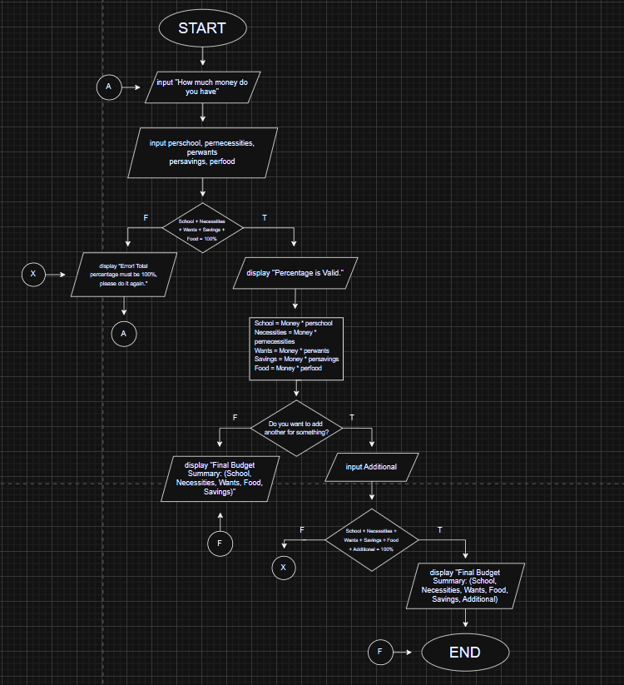





Logic Flow
The flowchart shows how the system will process user input, perform computations,
and display the results.
06

Slide 10

Example Output
How much money do you have?: 7500
Enter how many percent for Savings: 20%
Enter how many percent on Food: 28%
Enter how many percent on Necessities : 22%
Enter how many percent on Wants: 10%
Enter how many percent for School purposes: 20%
Do you want to add another? [YES\NO]
N0, so here is your budget for the month/week.
Budget for Savings: ₱1500
Budget for Food: ₱2100
Budget for Necessities: ₱1650
Budget for Wants: ₱750
Budget for School Purposes: ₱1500
05

Slide 11
Presentation #101
Thank You So Much
Thank You So Much
www.jazminispretty.com

